Slide 1

Data Manipulation using dplyr
Phil Canham
Corporate Insight Hub
October 2018
Notes:
Pye

Slide 2
The DPLYR package
Dplyr is a language for data manipulation.
Most wrangling puzzles can be solved with knowledge of just 6 dplyr verbs (6 functions).
These will be the subject of this session.
2

Slide 3
Key dplyr verbs
select
filter
mutate
arrange
group_by
summarise
3

Slide 4
The piping operator
%>%
Shortcut: Ctrl/Shift M
4

Slide 5
The piping operator
%>%
This operator means THEN
Shortcut: Ctrl/Shift M
This operator lets us chain events together, in order and really helps to simplify quite complex sets of tasks
Think of a recipe: There are a series of steps
5

Slide 6
Boiling an egg
Bring the water to a boil in a pan.
Reduce the water to a rapid simmer.
Add the egg.
Cook the egg for 5 to 7 minutes.
Cool the egg slightly.
Remove the top off the egg.
Eat while the egg is warm!
6

Slide 7
Boiling an egg
Bring the water to a boil in a pan THEN
Reduce the water to a rapid simmer. THEN
Add the egg. THEN
Cook the egg for 5 to 7 minutes. THEN
Cool the egg slightly. THEN
Remove the top off the egg. THEN
Eat while the egg is warm!
7

Slide 8
Boiling an egg
boil water in a pan %>%
Reduce the water to a rapid simmer. %>%
Add the egg. %>%
Cook the egg for 5 to 7 minutes. %>%
Cool the egg slightly. %>%
Remove the top off the egg. %>%
Eat while the egg is warm!
8

Slide 9
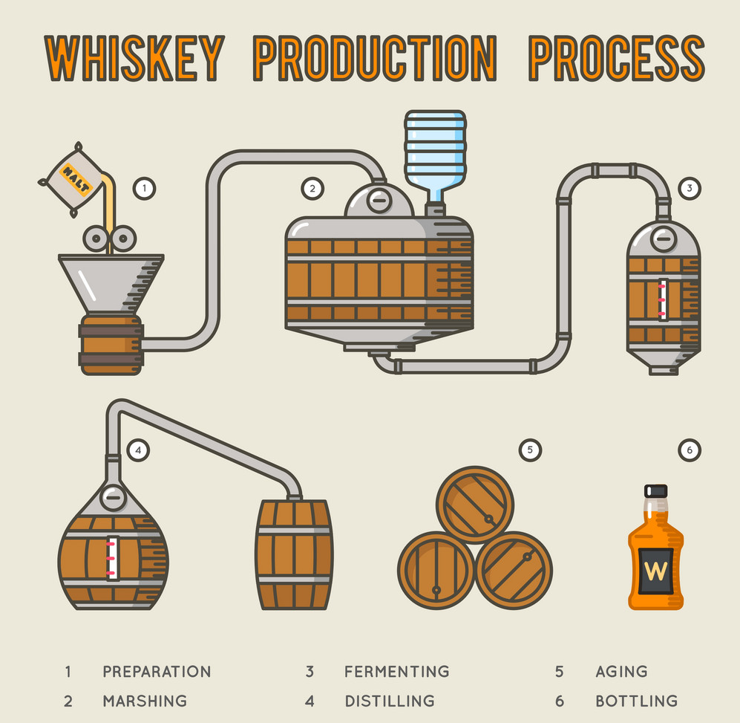
Whisky Production
%>%
%>%
%>%
%>%
%>%
%>%
%>%
9

Slide 10
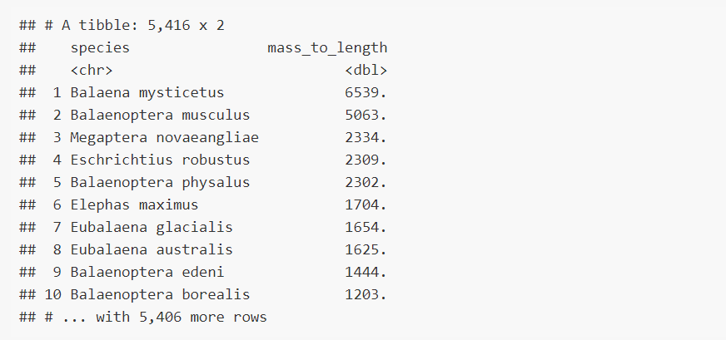
And onto piping dplyr verbs
Grab a data_frame call “mammals”
mammals %>%
mutate(mass_to_length = adult_body_mass_g / adult_head_body_len_mm) %>%
arrange(desc(mass_to_length)) %>%
select(species, mass_to_length)
10

Slide 11
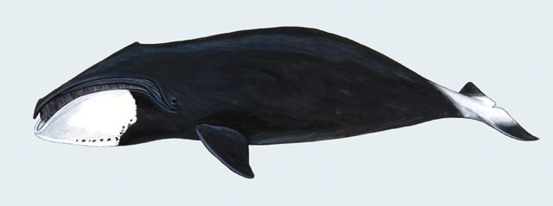
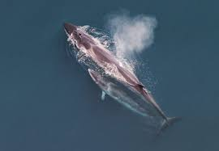
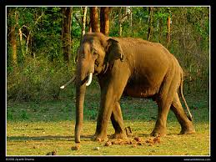
11

